Slide 1

Welcome to the Ag Biz Masters Year One Webinar!
March 4, 2026
12:00-1:30PM

Slide 2
Agenda for Today
Balance Sheet Where Do You Stand?
Alumni Spotlight

Slide 3
Balance Sheet Where Do You Stand?
Danny Jordan

Slide 4

Introduction
Insert Photo Here
Danny Jordan ​
YBS Relationship Manager

Slide 5
What can you expect to learn?
Understand the purpose of a balance sheet and how it shows your financial position at a point in time
Identify and classify assets and liabilities into current and non-current categories
Apply the accounting equation: Assets = Liabilities + Owner Equity
Interpret key financial indicators like net worth, working capital, and debt-to-asset ratio
Build a basic balance sheet for your farm or agribusiness using provided examples

Slide 6
The Balance Sheet
One of Four Key Financial Statements
Balance Sheet
Statement of Owner Equity
Income Statement
Statement of Cash Flows
Cash Flow Budget

Slide 7
The Substance
It Tells Us…
Financial position at a point in time
Equity or Net Worth
3 parts of the accounting equation
ASSETS = LIABILITIES + OWNER EQUITY
It Contains…
Detail of things owned and owed
Current and Non-Current class or category
Sometimes - Current, Intermediate, Long Term

Slide 8
Which Balance Sheet?
The Business
The whole business
A segment (entity) or enterprise thereof
Personal
Individual owners
May include a % of the business
Consolidated vs. Separate

Slide 9
Why a Balance Sheet
Key Economic Indicators
Net Worth Change
Rates of Return: On Assets, On Equity
Working Capital (Current assets – current liabilities)
Current Ratio
Debt to Asset Ratio
Equity Ratio or Percent Equity
Asset Turnover Rate

Slide 10
Timing
End of the business year
12/31/YYYY for many
Fiscal date for some (i.e. 9/30/YYYY)
Coincides with INCOME STATEMENT
Request for financing
Monitoring business performance
Is the equity trending upward? Downward?

Slide 11
Cost vs. Market Value
Cost Value
Original cost less accumulated depreciation
Accumulated depreciation = tax depreciation
Market Value
Fair market value
Original cost less economic depreciation
Or plus appreciation

Slide 12
Assets
Current
Cash
Can be turned into cash within 12 months
Consumed within a year
Non-Current
Support production activities
Useful life greater than 1 year

Slide 13
Current Assets
Examples
Cash, checking, savings, CDs, etc.
Marketable securities:
Intended to convert to cash in 12 months
Accounts Receivable
Marketable Inventories:
Crops/livestock held for sale
Investment in growing crops
Supplies on hand:
Feed, fuel, crop inputs
Prepaid expenses
Paid for but not yet consumed: feed, seed, crop & livestock supplies

Slide 14
Non-Current Assets
Examples
Machinery and Equipment
Breeding Livestock
Long term securities (retirement funds)
Cooperative stock and equity
Real estate
Land
Buildings and Improvements (drainage, fencing, silos)

Slide 15
Determining the Value of Assets
Financial records
Checkbook ledger, software reports
Year-end statements
Appraisals
Commodity prices
KEY GOAL – Increase assets & Net Worth by EARNINGS more so than by valuations

Slide 16
Liabilities
Current Liabilities
Debts and obligations due in 12 months
Non-Current Liabilities
Obligations due and payable beyond one year

Slide 17
Current Liabilities
Examples
Accounts payable – (unpaid bills)
Operating and Commodity Loans
Principal portion of term debt due in next year
Accrued Interest
Accrued Taxes – income and property
Credit Card Debt
Other Accrued Expenses - rents, wages

Slide 18
Non-Current Liabilities
Examples
Machinery and Equipment Loans
Auto Loans
Personal Loans
Real Estate Loans

Slide 19
Special Considerations
Leases
List the lease payments for next 12 months as current liability
List the remaining lease obligation as a non-current liability
List the remaining lease obligation as a non-current asset

Slide 20
Special Considerations
Deferred Taxes
Potential tax on future sales of assets
Capital Gains
Depreciation Recapture

Slide 21
Contingent Liabilities
Potential for obligation exists
Co-signed loan
Pending lawsuit

Slide 22
Business vs. Personal
When to include personal assets & liabilities
Yes – Evaluate personal net worth
Yes – Loan applications
No – Business Analysis

Slide 23
Balance Sheet Summary
Everyone should have one
Net worth (equity) snapshot
Important financial document
Assets = Debt + Owner Equity
At least once per year at fiscal year end
The hardest one is the first one
Increase NET WORTH by EARNINGS

Slide 24

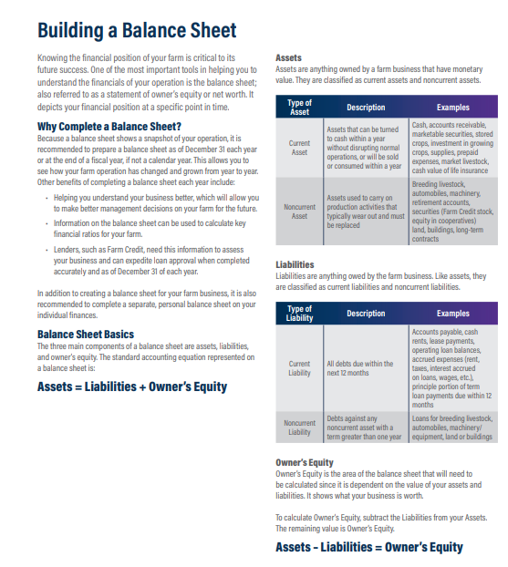
Building A Balance Sheet Exercise

Slide 25
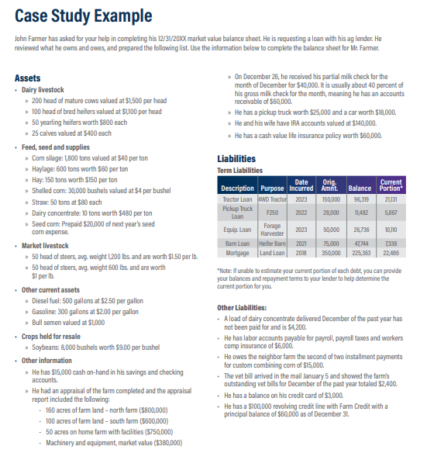
Balance Sheet Case Study Example

Slide 26
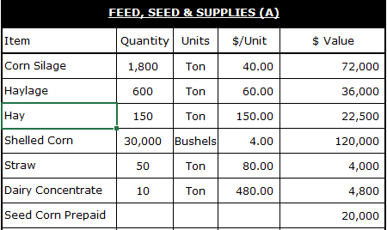
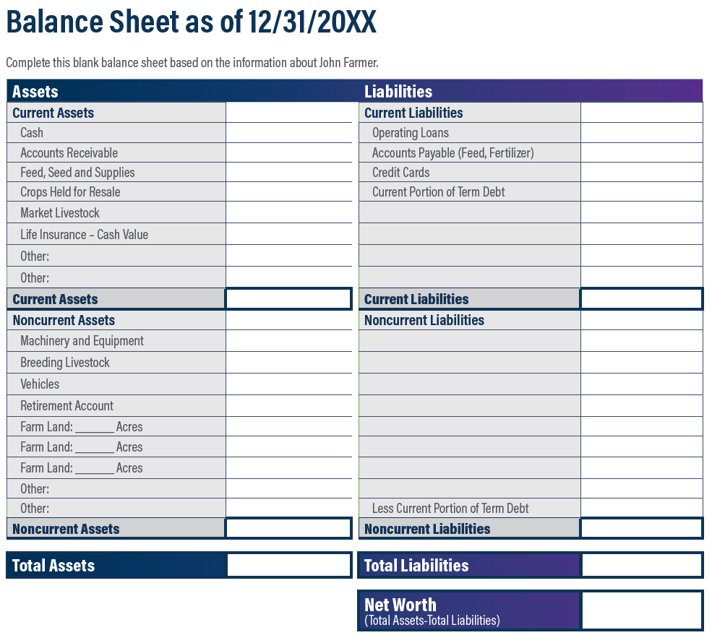
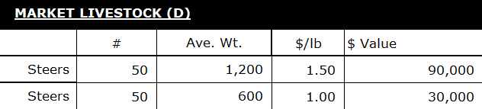
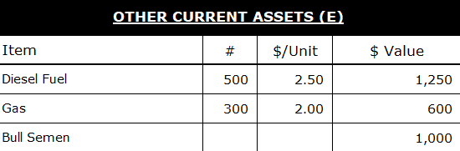
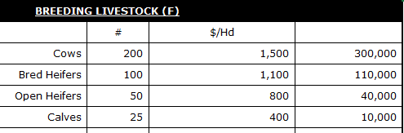
279,300
120,000
2,850
460,000

Slide 27
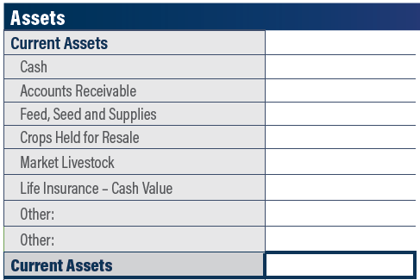
15,000
60,000
279,300
72,000
120,000
60,000
2,850
609,150

Slide 28
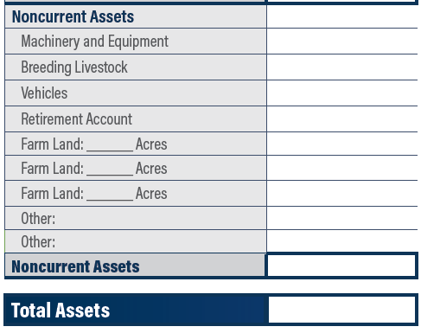
380,000
460,000
43,000
140,000
160
800,000
100
600,000
50
750,000
3,173,000
3,782,150

Slide 29
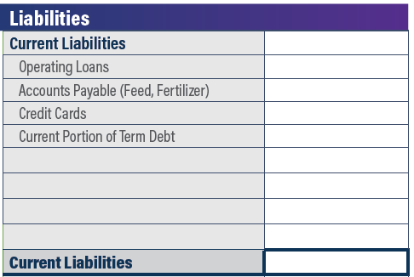
60,000
27,600
3,000
66,932
157,532

Slide 30
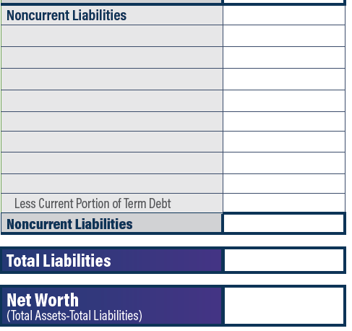
Tractor Loan
$96,319
Pickup Truck Loan
$11,482
Equipment Loan
$26,736
Barn Loan
$47,744
Farm Mortgage
$225,363
(66,932)
$340,712
$498,244
$3,283,906

Slide 31
Any Questions?

Slide 32
Danny Jordan
DJordan@HorizonFC.com
717.693.2430

Slide 33
Break

Slide 34
Alumni Spotlight

Slide 35
Course Wrap-up
Complete all five of your eLearning modules and the course evaluation in FCU
All class assignments and modules need to be completed by March 20, 2026 to be eligible for the course fee scholarship reimbursement.
If you paid via credit card, your reimbursement will be refunded to to your credit card on file.
If you plan to take Year 2, registration will open next Fall and the course will follow a similar structure.
Notes:
Jo

Slide 36
Webinar Survey
https://www.surveymonkey.com/r/7RF2LRR

Slide 37
Questions?
Johanna Rohrer
Jrohrer@HorizonFC.com
717.740.1561

